Slide 1

The Bridges
of Königsberg
and other examples relating to graph theory

Slide 2
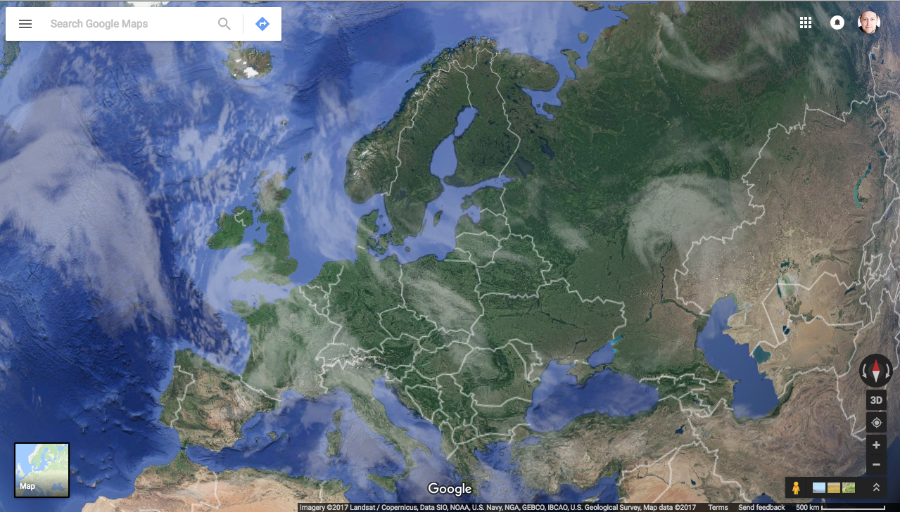
Let’s go to Kaliningrad

Slide 3
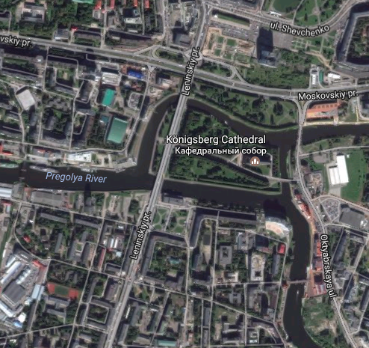

Konigsberg

Slide 4
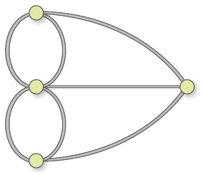
Let’s get abstracted!
Can you find a route that will traverse each edge exactly once?
This is known as an Eulerian Circuit.

Slide 5
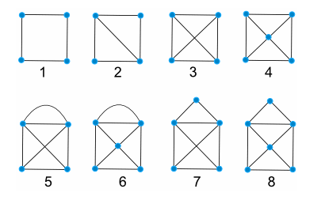
Why is there no solution?
Look at the following diagrams. With which of these diagrams is it possible to traverse all the edges exactly once?
Shape # | Eulerian Circuit?
1 | True
2 | True
3
4
5
6
7
8

Slide 6
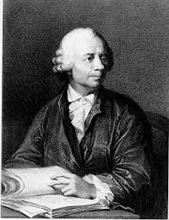
Euler’s Solution
Euler’s solution to the Konigsberg Bridge Problem was demonstrating that it was not possible to find a solution in the first place.
He said that in order for an Eulerian path to exist, there must be either 0 or 2 odd degree vertices in total. Any more and it’s just not possible to traverse every edge exactly once.
Only the start and end node can have an odd degree. In order to traverse every edge, you must enter and exit every other node meaning that their degrees have to be even.

Slide 7
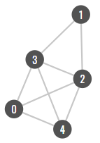
Extension: Write code to determine if the following graph is an eulerian circuit
for n in [[0,130,228], [1,217,106], [2,219,189], [3,157,164], [4,193,254]]: new_node = graph.add_node(id =n[0]) new_node.set_position(n[1], n[2], relative = False) for e in [[1,3], [2,1], [2,3], [4,2], [0,2], [0,4], [0,3], [3,4]]: new_edge = graph.add_edge(graph.node(e[0]), graph.node(e[1]))

